Slide 1
Project Complexity Analysis Using SmartShark Dataset
Kameswara Pullabhotla (Z1891893)
Ramanadha Kaushik Jagarlapudi (Z1946140)

Slide 2
Motivation
Analyzing project complexities and the success ratios depending on the issue complexity and build efficiency

Slide 3
Dataset
We are using SmartShark dataset for this analysis
Tables Included:
event
issue
issue_system
project
travis_build
travis_job
vcs_system
commit

Slide 4
Research Question
Phase-1
Determining complexity of issues and extending the same in finding the complexity of project.

Slide 5
Independent & Dependent Variable
Phase-1
Independent Variables
issue_type
issue_priority
issue_hours

Slide 6
Independent & Dependent Variables
Priority Value:
Blocker/Critical: 1
Major: 2
Trivial/Minor: 3
Issue Type:
Bug, Technical task, Story, Improvement, Dependency upgrade: 1
New Feature, Task, Sub-task, Test, Brainstorming, Documentation: 2
Question, Wish, Epic: 3

Slide 7
Methods
Elbow Method
K-Means Clustering

Slide 8
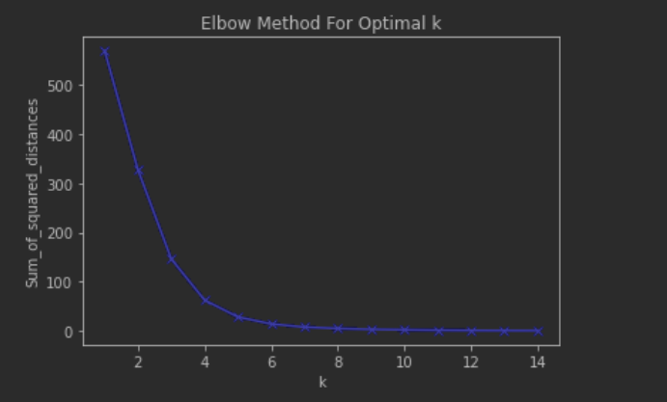
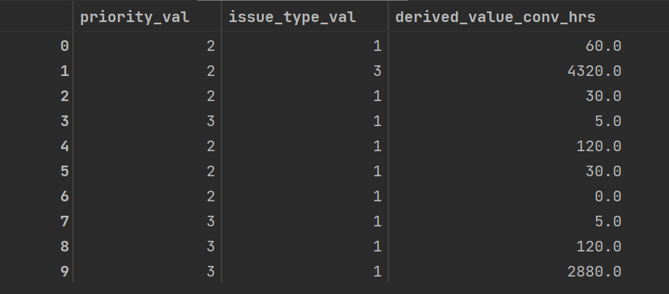
Results
Sample Dataset

Slide 9
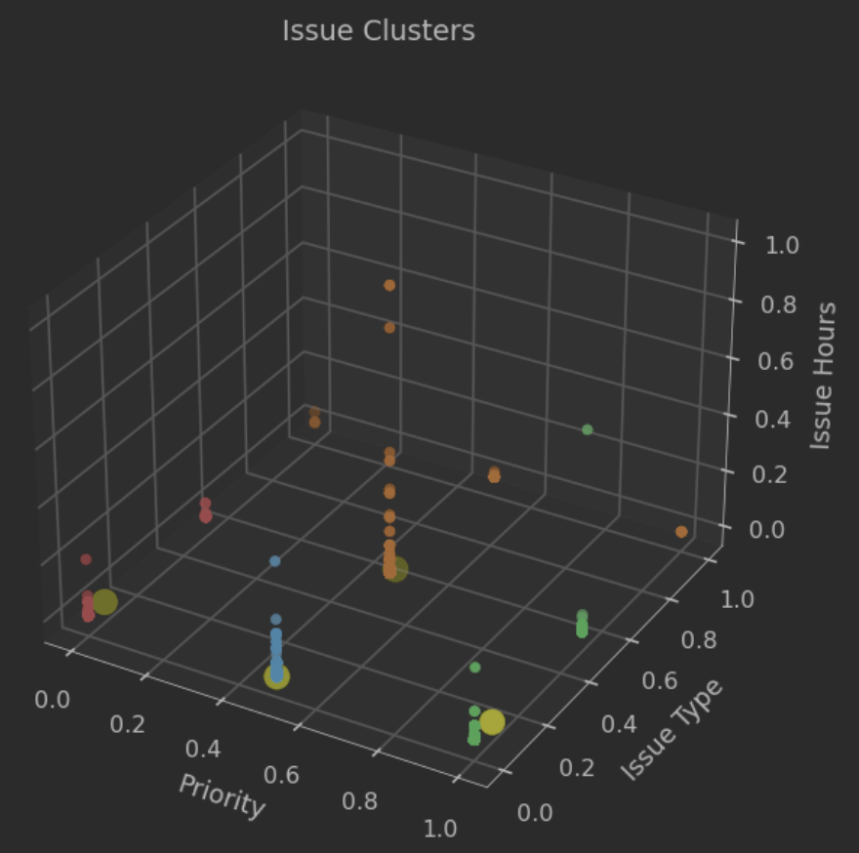

Continued…
0
1
2
3

Slide 10
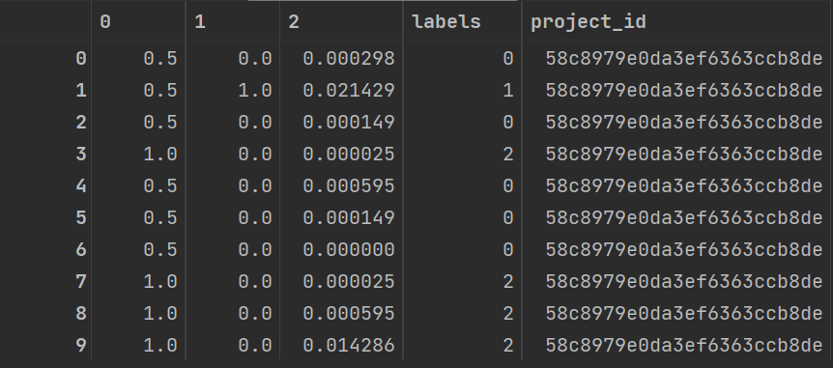
Continued…
Project Cluster

Slide 11
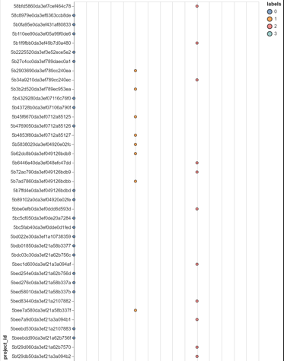
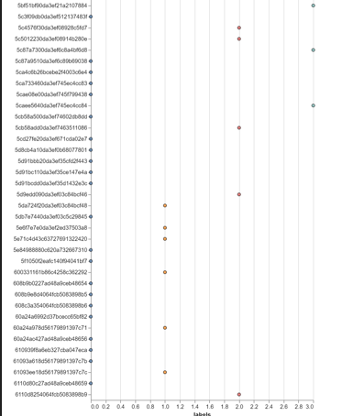
Continued…

Slide 12
Research Question
Phase-2
Determining the success ratio of projects with respect to build success rates.

Slide 13
Independent & Dependent Variables
Phase-2
Independent Variables
state
event_type
duration

Slide 14
Independent & Dependent Variables
Event Type:
Push: 1
Cron: 2
API: 3
State:
Failed: 1
Passed: 2
Errored: 3
Canceled: 4

Slide 15
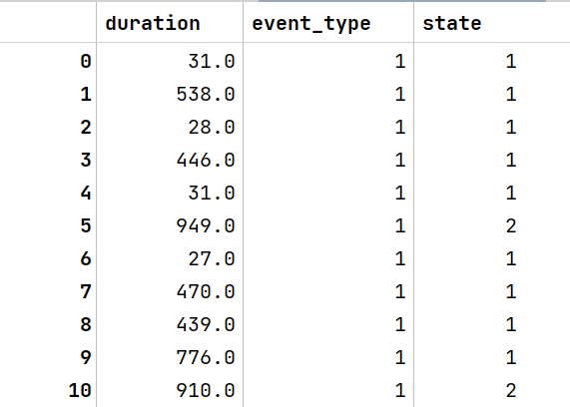
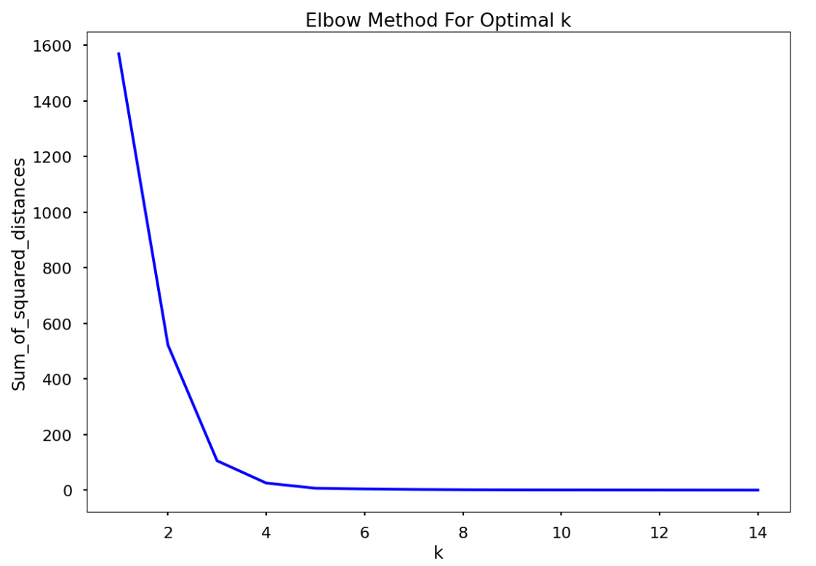
Results

Slide 16
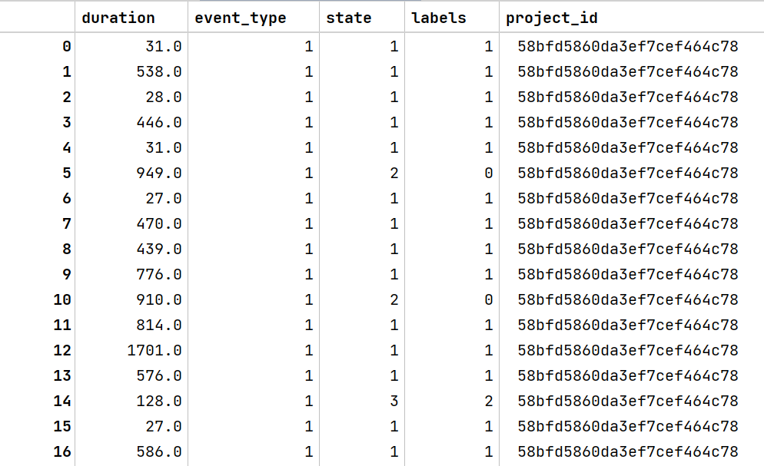
Continued…
Project clusters along with their success ratio labels

Slide 17
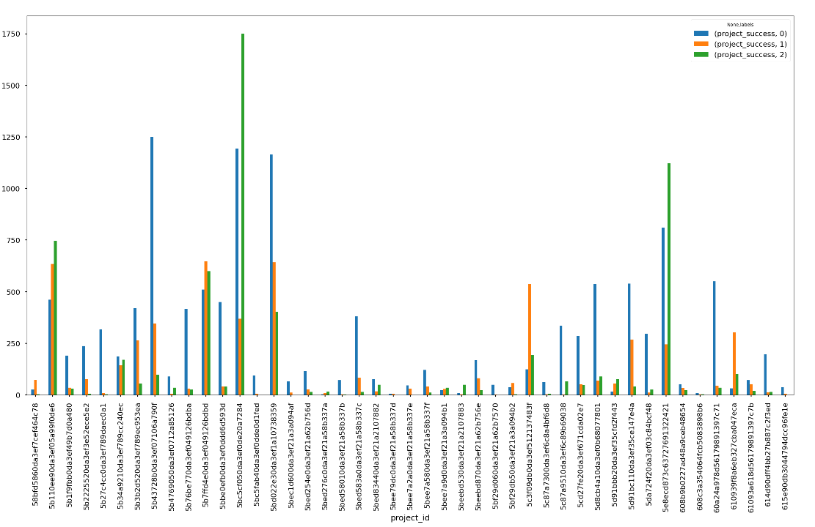
Continued…

Slide 18
Conclusion & Future Work
Since this is an unsupervised learning problem, we have assessed the results of Models 1 and 2, which involve clustering projects based on complexity, and Model 2, which involves manually calculating the success ratios of the projects by examining the values in the SmartShark dataset and the conclusions drawn from the bar graph. This can be improved by adding the extensive SmartShark dataset and committer or developer-related information to assess developers' productivity on a project-by-project basis. This can then be applied as a dependent metric for the project complexity estimates made in this work using Model-2.

